Slide 1
DSC3108: Big Data Mining and Analytics
Lecture 06 (BSCS_3:1)
Topic: Other Data Mining Techniques-Association Mining
Dr. Daphne Nyachaki Bitalo
Department of Computing & Technology
Faculty of Engineering, Design & Technology
Thur 26th Sept 2024

Slide 2

COURSE OVERVIEW
Big Data
Fundamentals and Mining
Data Analytics
Architectures, storage of data
Data Mining Techniques
Descriptive analytics
Predictive analytics
Notes:
Limited empirical investigation into the challenges encountered by Master's degree students
during the dissertation writing process contributes to difficulties in completing dissertations, resulting in elevated dropout rates and delayed program completion. This study seeks to fill this research gap by examining the specific challenges and solutions.

Slide 3
Lecture Objectives and Learning outcomes
The Objectives of this lecture are :
Understand association data mining techniques that can be used for predictive analyses
By the end of this lecture, students should be able to:
Get practical experience working with association mining algorithms and unsupervised learning.

Slide 4
Lecture Overview
Data Mining Techniques
Association mining parameters
Association mining algorithms
Applications of association mining
Hands-on practical

Slide 5
Data Mining Techniques
Data mining process: CRISP-DM methodology
Data exploration and visualization
Association rule mining
Classification algorithms (Decision trees, Naïve Bayes, Support Vector Machines)
Clustering algorithms (K-means, hierarchical clustering)
Outlier detection

Slide 6
CRISP-DM Method
CRISP-DM (Cross-Industry Standard Process for Data Mining) is a widely used methodology that provides a framework for conducting data mining projects. It outlines a series of phases that guide the process from business understanding to deployment.
Documentation: Maintain clear documentation throughout the project.

Slide 7
CRISP-DM Method
Phases of CRISP-DM:
Business Understanding:
Define the business objectives and goals.
Identify the relevant data sources.
Create a project plan.
Data Understanding:
Collect and gather the necessary data.
Explore the data to understand its characteristics, quality, and completeness.
Identify potential data quality issues.

Slide 8
CRISP-DM Method
3. Data Preparation:
Clean and preprocess the data to address any quality issues.
Transform the data into a suitable format for analysis.
Create features or attributes that are relevant to the problem.
4. Modeling:
Select appropriate data mining techniques based on the business objectives.
Build and train models using the prepared data.
Evaluate the performance of the models.

Slide 9
CRISP-DM Method
5. Evaluation:
Assess the quality and reliability of the models.
Compare the performance of different models.
Validate the models using unseen data.
6. Deployment:
Integrate the chosen model into the production environment.
Monitor the model's performance and update it as needed.

Slide 10
Data exploration and visualisation
In data mining, exploration helps an analyst understand the data, identify patterns, and communicate findings effectively.
Handles various aspects such as;
Summary Statistics: Calculate measures like mean, median, mode, standard deviation, and percentiles to get a basic understanding of the data distribution.
Data Profiling: Examine data types, missing values, outliers, and inconsistencies.
Univariate Analysis: Analyze individual variables to understand their distributions and characteristics.

Slide 11
Data exploration and visualisation
Handles various aspects such as;
Bivariate Analysis: Examine relationships between pairs of variables.
Multivariate Analysis: Explore relationships among multiple variables.
Data Storytelling: Use visualizations to create compelling narratives and communicate insights effectively.

Slide 12
Association rule mining
This technique discovers interesting relationships between items in a large dataset. These relationships, typically represented as rules, can be used to make predictions or recommendations.
The technique uses unsupervised machine learning algorithms to find the hidden rules (associations) in data
Association rule mining assigns key statistical parameters that are different from correlations (i.e. Support, Lift, Confidence)

Slide 13
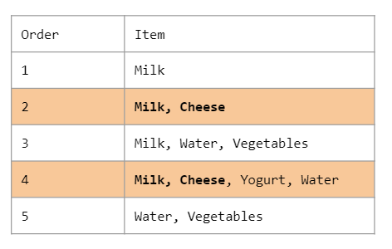
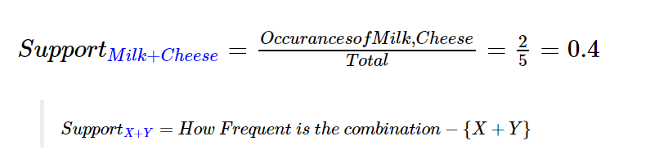
Association rule mining parameters
Support
Support is a measure of how frequent a item or an item set appears in a dataset. For example, what is the support for the item set { Milk + Cheese } everytime a customer goes to a shop?

Slide 14
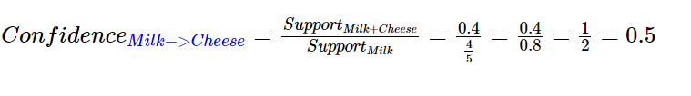
Association rule mining parameters
2. Confidence
Confidence is a measure of how often this rule is found to be true. Or the probability that an event will occur given that another event has occurred. So what is the probability that a customer who purchases milk will also purchase cheese?

Slide 15
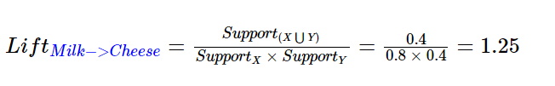
Association rule mining parameters
3. Lift
Lift defines that strength of the relationship or association of purchasing milk and cheese

Slide 16
Association rule mining algorithms
Apriori algorithm
The Apriori Algorithm searches through small datasets to identify different rules(associations). In this algorithm, there are product clusters that pass frequently, and then strong relationships between these products and other products are sought.
It's designed to efficiently discover frequent itemsets and association rules in small datasets.
Association rule: A rule of the form X → Y, where X and Y are itemsets. X is called the antecedent, and Y is called the consequent.
Support: The fraction of transactions that contain both X and Y.
Confidence: The probability that Y will occur given that X has occurred.

Slide 17
Association rule mining algorithms
2. FP-Growth algorithm
The frequent pattern growth algorithm also uses unsupervised learning but is more efficient than apriori algorithm
The algorithm uses a divide-and-conquer approach to generate frequent itemsets efficiently. The main idea of the FP-growth algorithm is to represent the dataset in a compact form called the frequent pattern tree
Limited to categorical data only.

Slide 18
Association rule mining algorithms
3. ECLAT algorithm
Equivalence Class Clustering and List Intersection offers a more efficient approach compared to Apriori, especially for dense datasets.
Key Concepts:
Equivalence class: A group of items that always appear together in transactions.
Item prefix: The initial part of an itemset.
Item list: A list of transactions that contain a specific item.

Slide 19
Applications of association mining
Market basket analysis: Identifying products that are frequently purchased together.
Recommendation systems: Suggesting items to users based on their past purchases or preferences.
Web usage mining: Analyzing user behavior on a website to improve its design.
Medical diagnosis: Identifying patterns in patient data to assist in diagnosis.

Slide 20
In-class practical
Import the necessary libraries for association rule mining:
Libraries in python:
mlextend,
apyori,
Apriori
Use the datasets provided on Moodle

